Slide 1
Data Encryption Standard (DES)

Slide 2
Introduction

Slide 3
Facts
Blocks of size 64 bit
Developed by IBM under influence of the National Security Agency (NSA)
Most popular block cipher for most of the last 30 years
Insecure due to the small key length of 56 bit
Replaced by the Advanced Encryption Standard

Slide 4
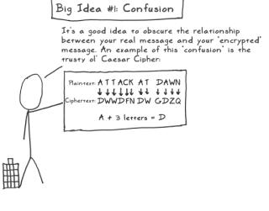
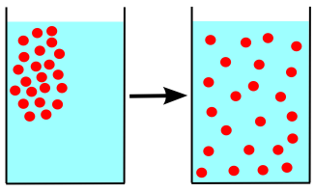
Block Cipher Primitives: Confusion and Diffusion
Confusion: An encryption operation where the relationship between key and ciphertext is obscured.
substitution
Diffusion: An encryption operation where the influence of one plaintext symbol is spread over many ciphertext symbols with the goal of hiding statistical properties of the plaintext.
bit permutation,

Slide 5
High level view

Slide 6
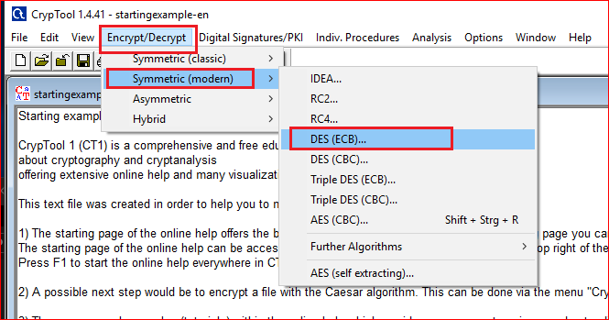

Slide 7
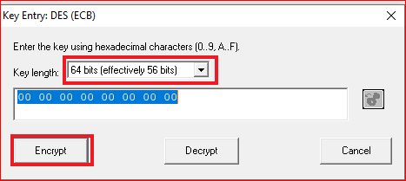
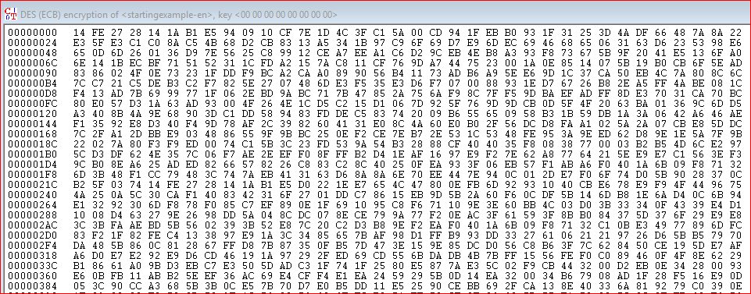

Slide 8
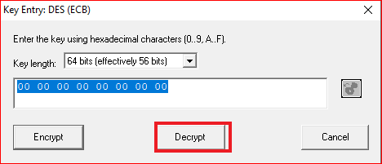
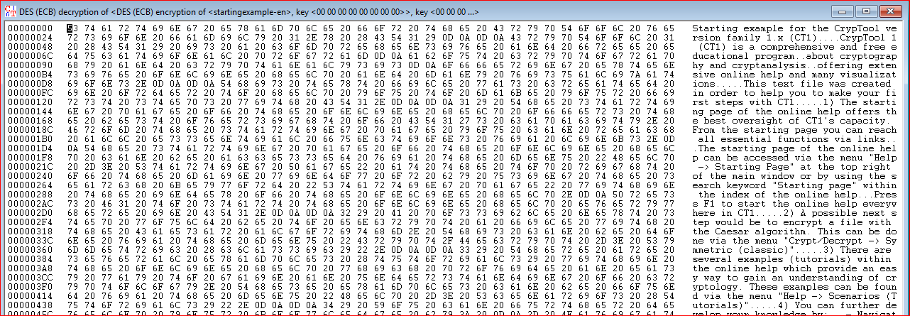

Slide 9
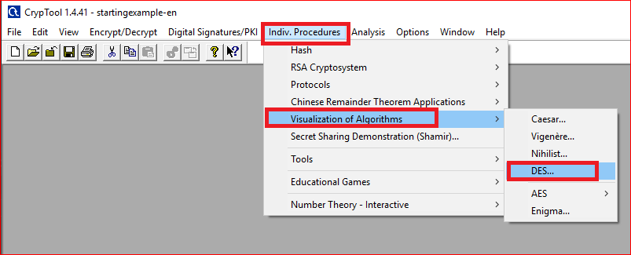

Slide 10
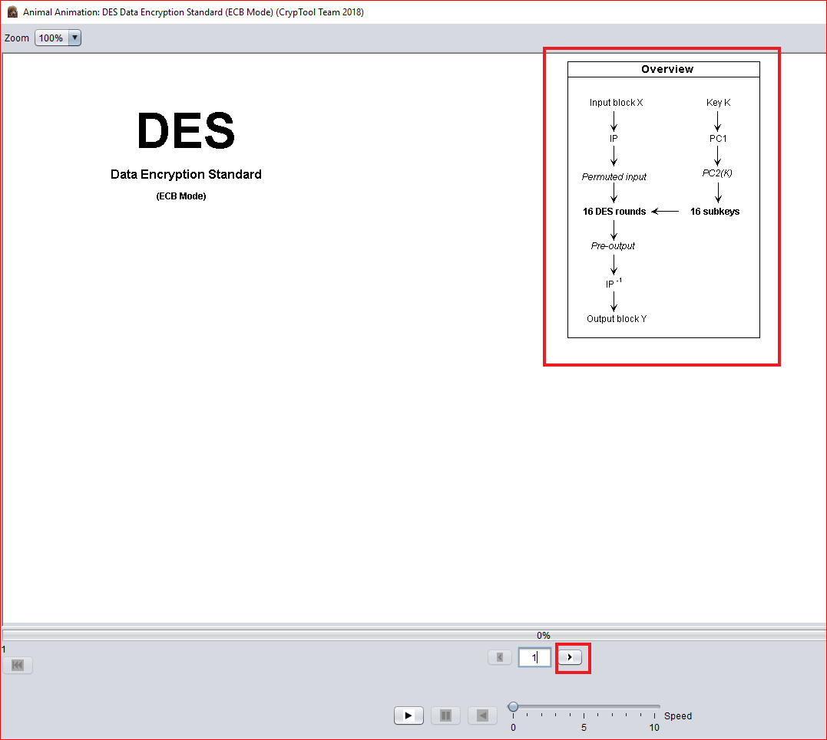

Slide 11
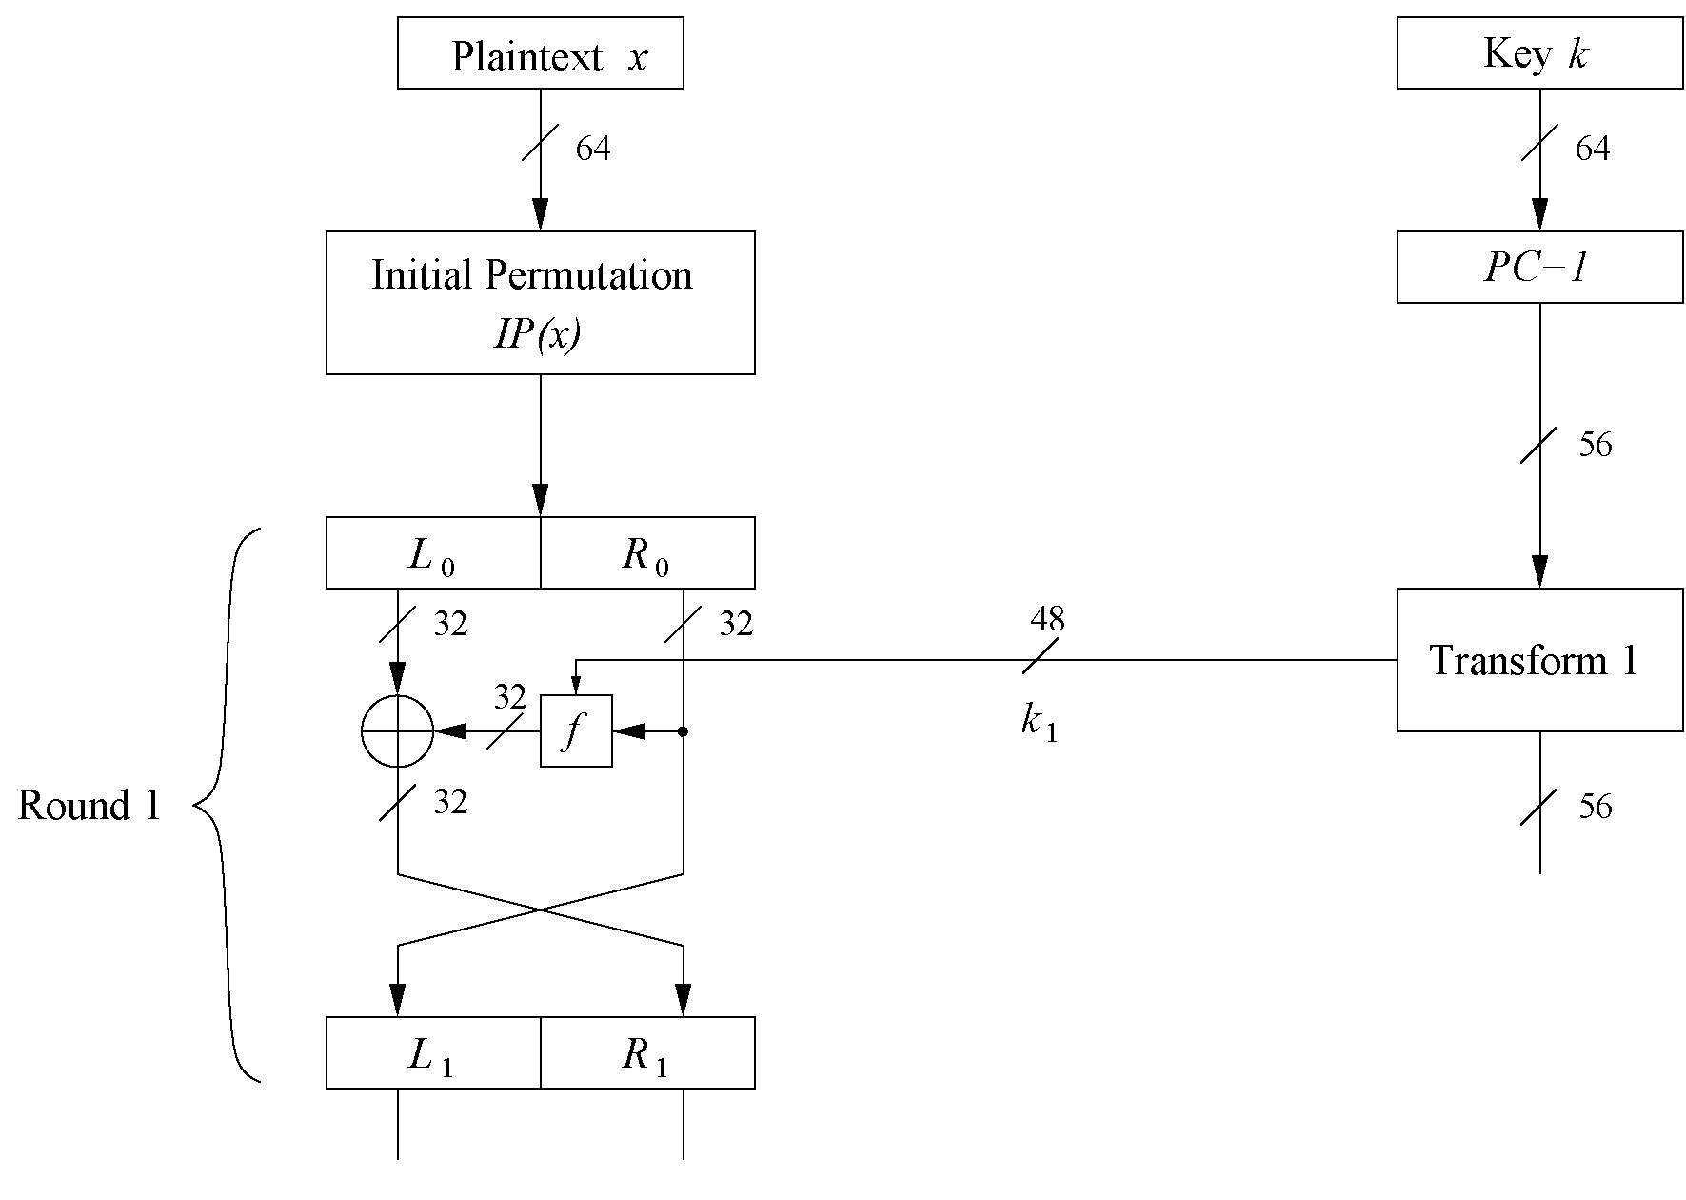

Slide 12
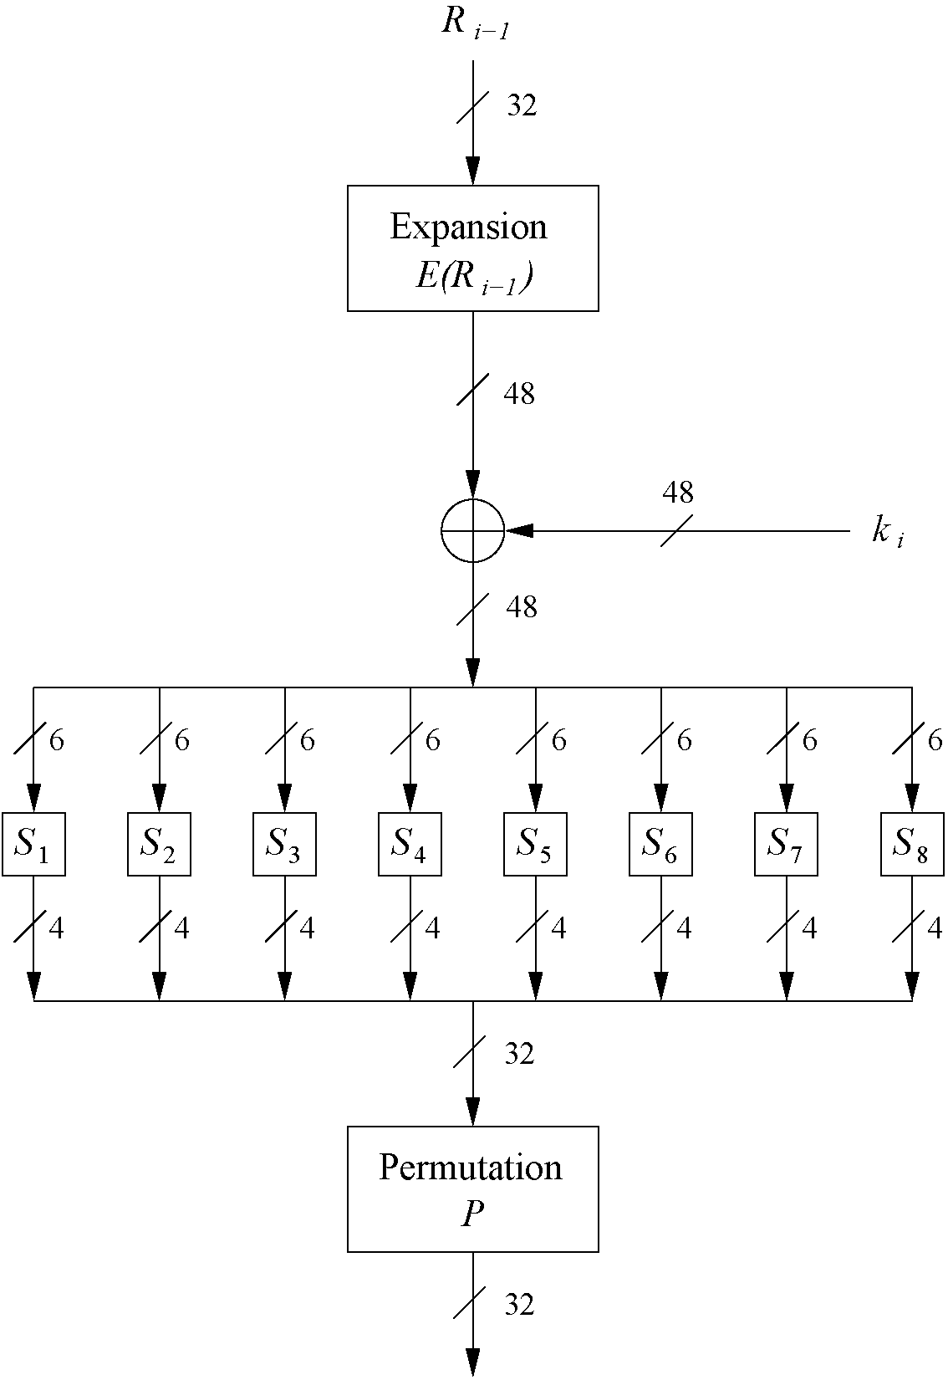
The f-Function
main operation of DES
f-Function inputs: R_{i-1} and round key k_{i}
4 Steps:
Expansion E
XOR with round key
S-box substitution
Permutation

Slide 13
Question
All inputs are “0”, what is the output of the first around?

